Slide 1
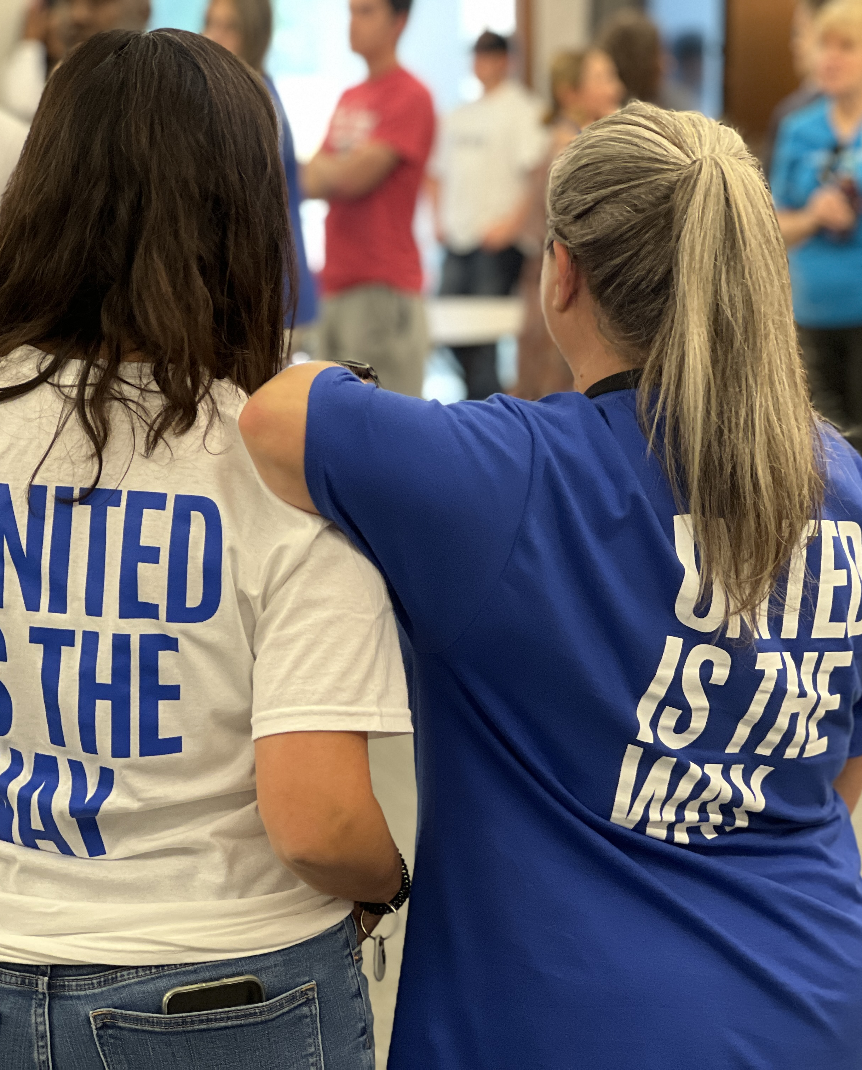
2026 Major Grant Program
Financial Empowerment Major Grant

Slide 2
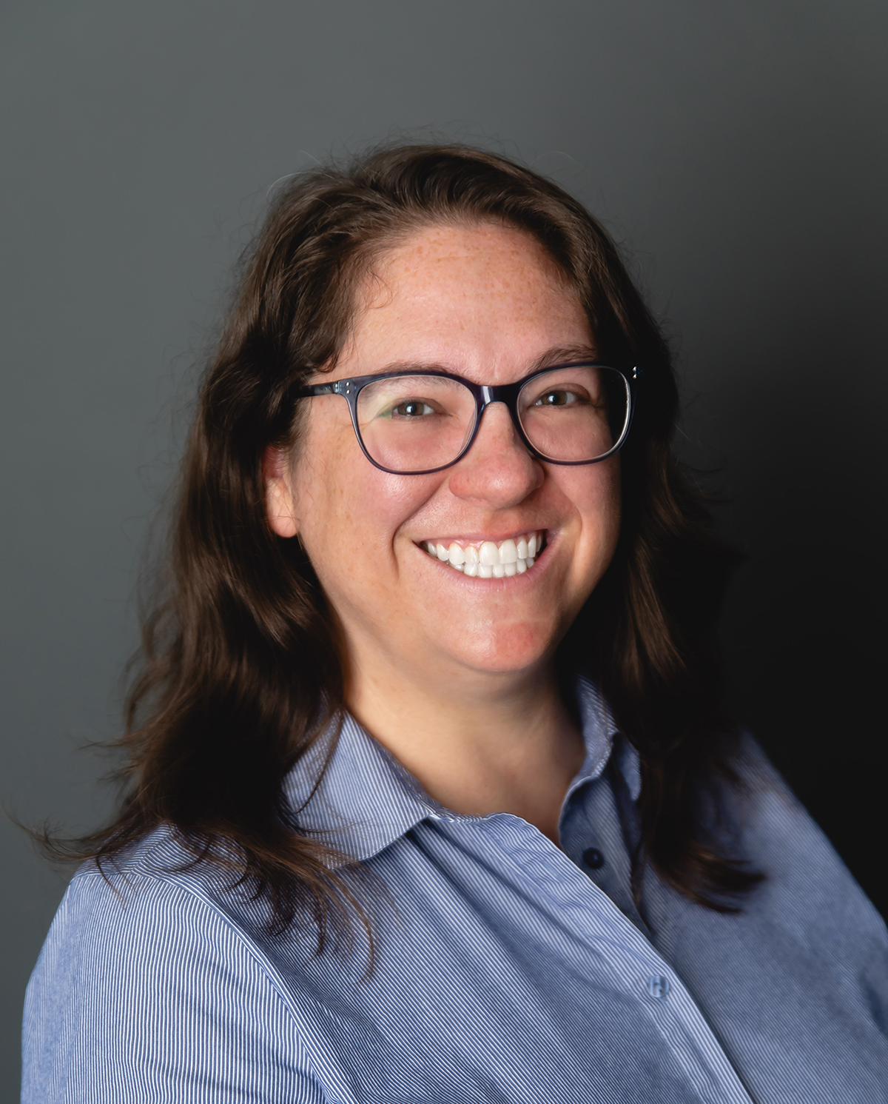
Sarah Mansell
Community Impact Director
SMansell@uwstory.org

Slide 3
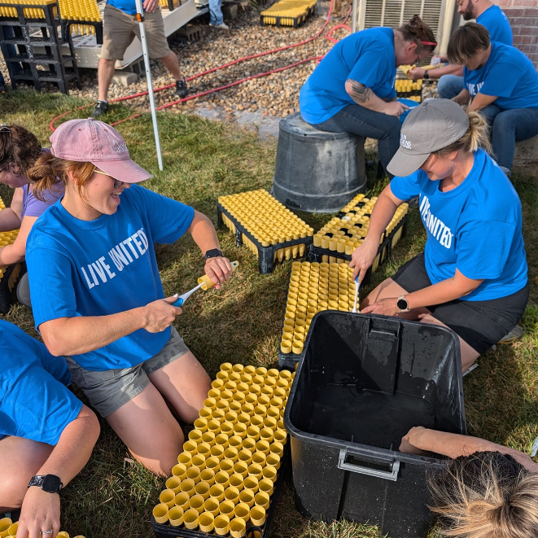
Our Vision
A connected and thriving Story County
Our Mission
Unite people, ideas, and resources to transform Story County

Slide 4
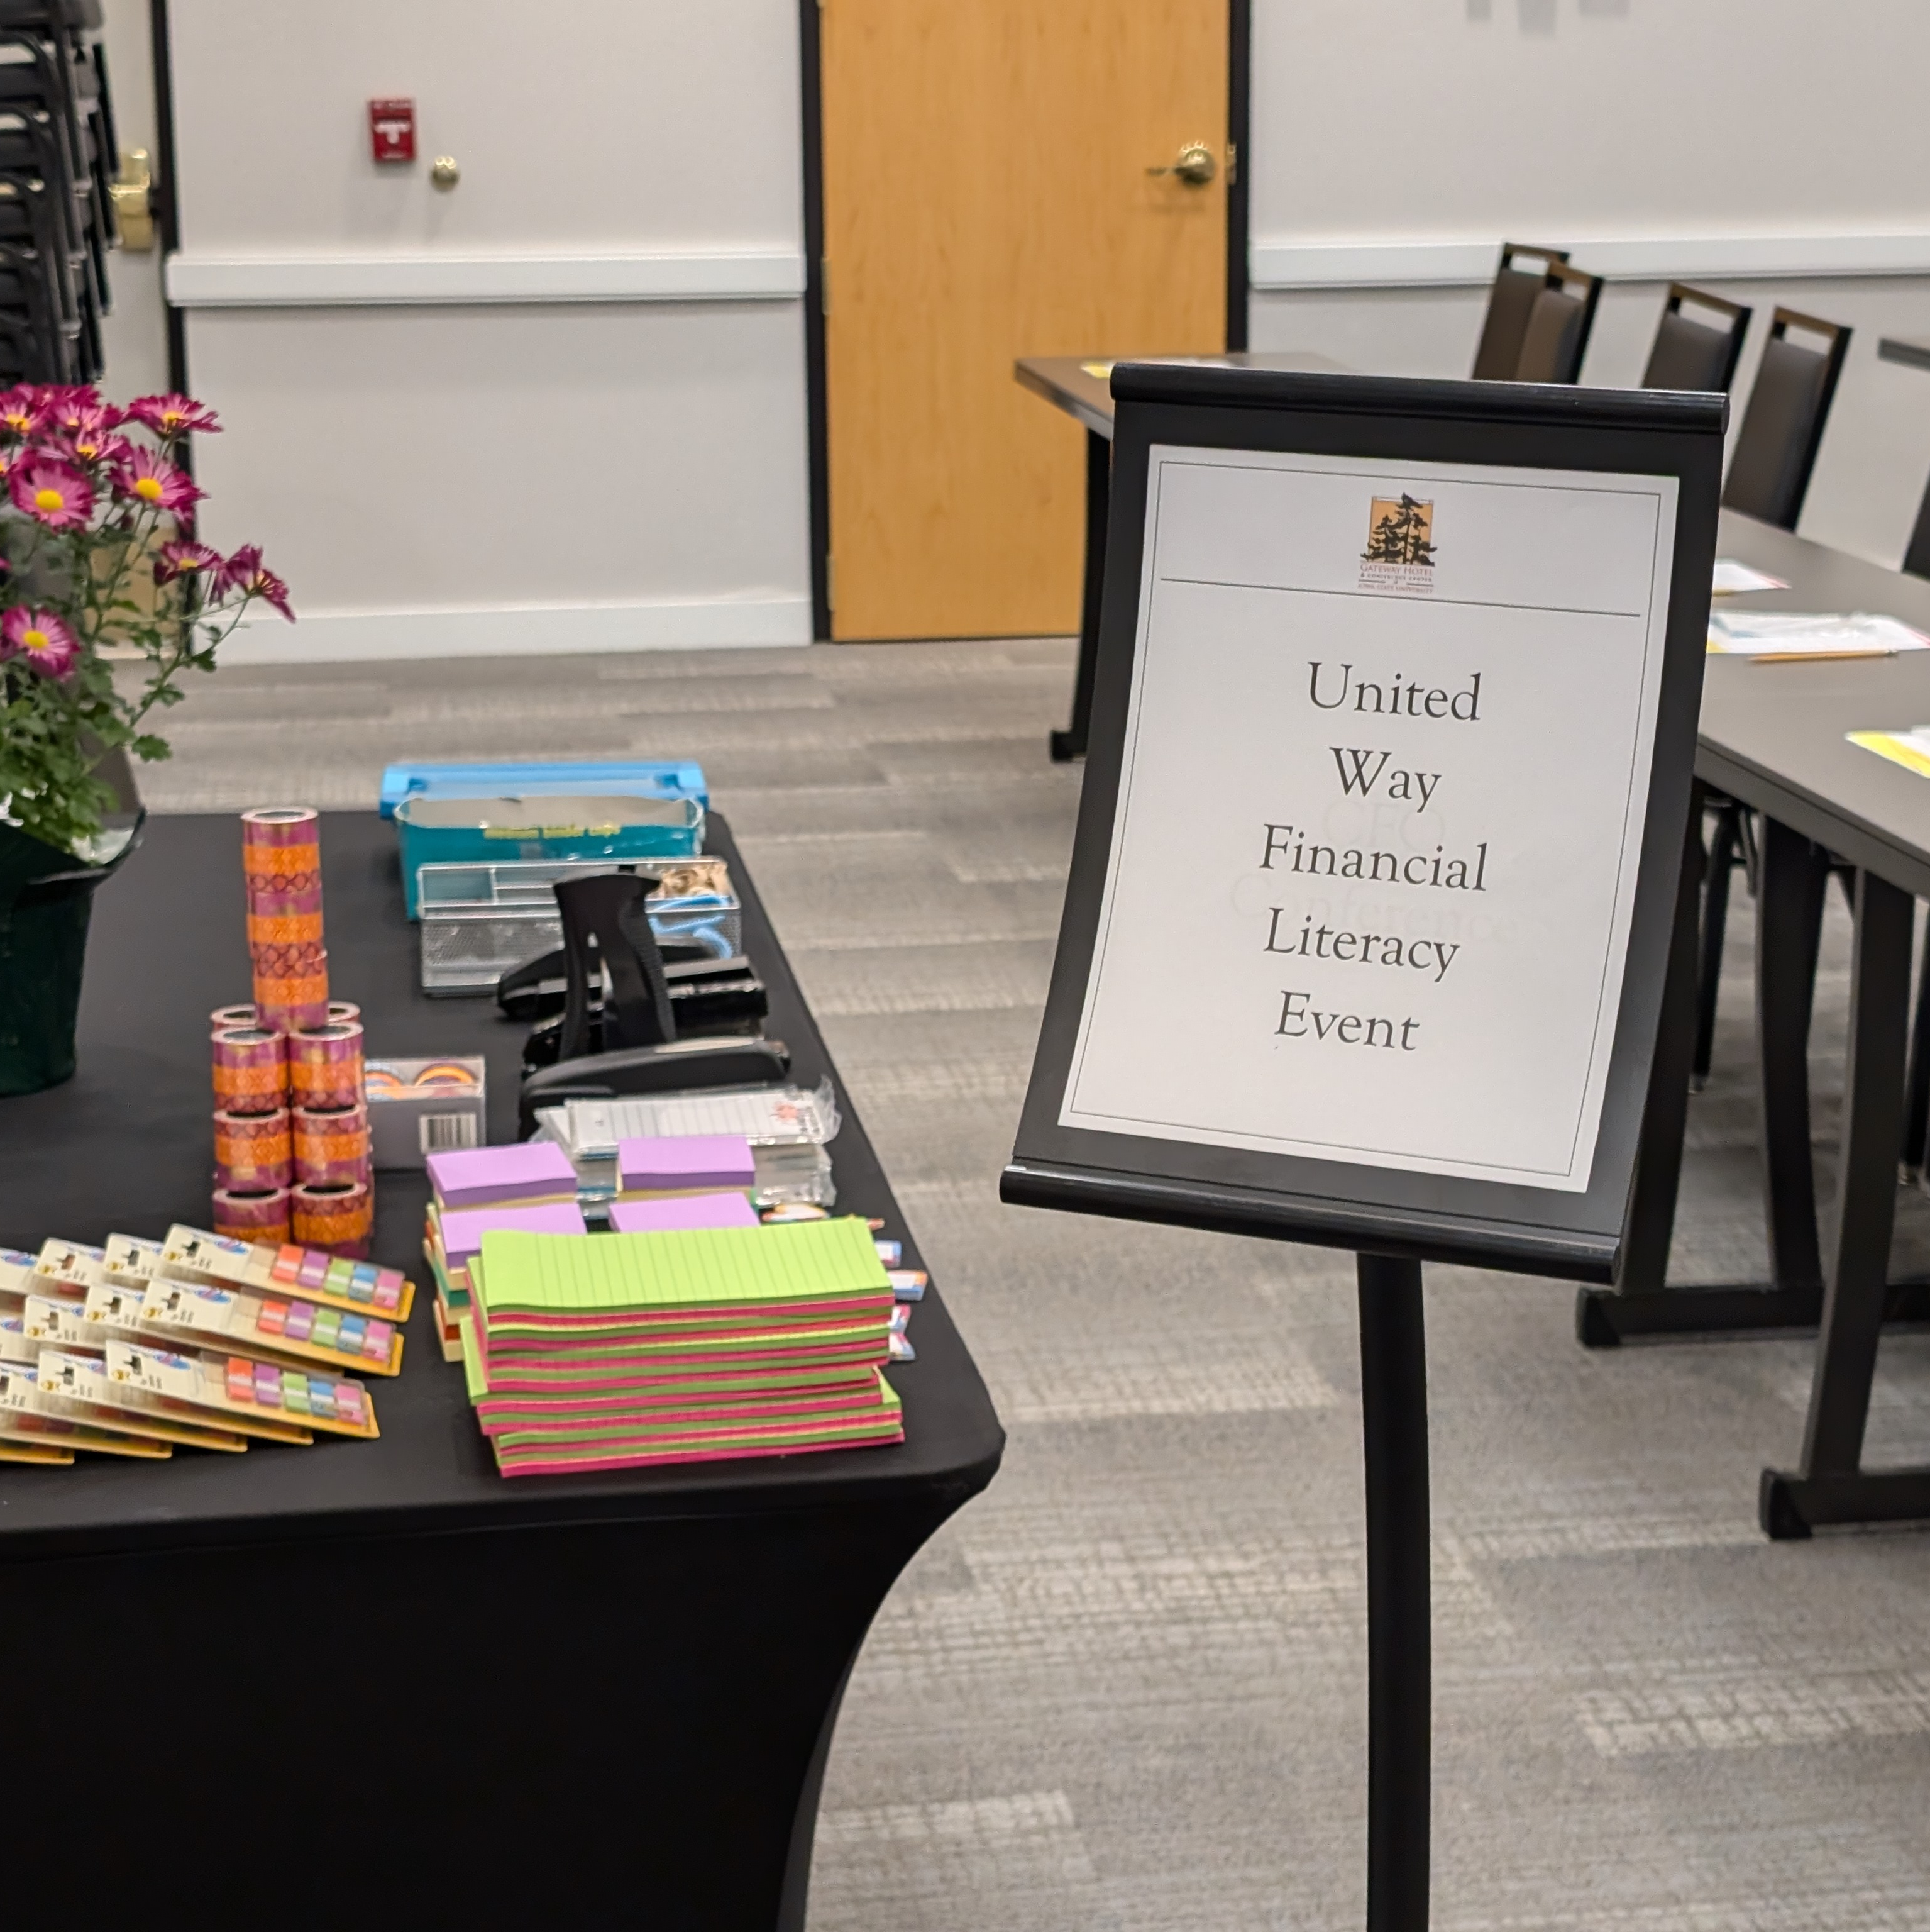
Agenda
United Way of Story County 2030 Impact Agenda
Overview of Request for Proposal (RFP)
Project Topics and Activities
Drafting a Successful Application
Submitting Your Application

Slide 5
2030 Impact Agenda
1

Slide 6



Deliver 12,500 high-quality early childhood educational opportunities
Invest in tools to build long-term financial stability for 1,000 households annually
Meet basic needs while fostering 15,000 meaningful connections

Slide 7
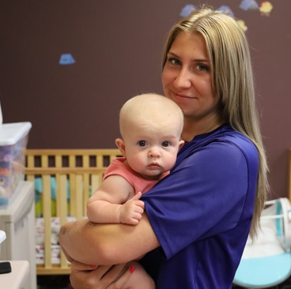
Financial Empowerment
OUR RESPONSE: Invest in tools to build long-term financial stability to 1,000 households annually
26% of Story County households don’t have $400 on hand for emergencies
49% of renting households spend 30% or more of their income on rent
Access to supportive programs helps individuals and families manage limited resources, avoid financial pitfalls, and build long-term stability
When families understand how to budget, save, and plan, they’re better equipped to handle emergencies, reduce stress, and create long-term stability that can break cycles of poverty and open doors to opportunity

Slide 8
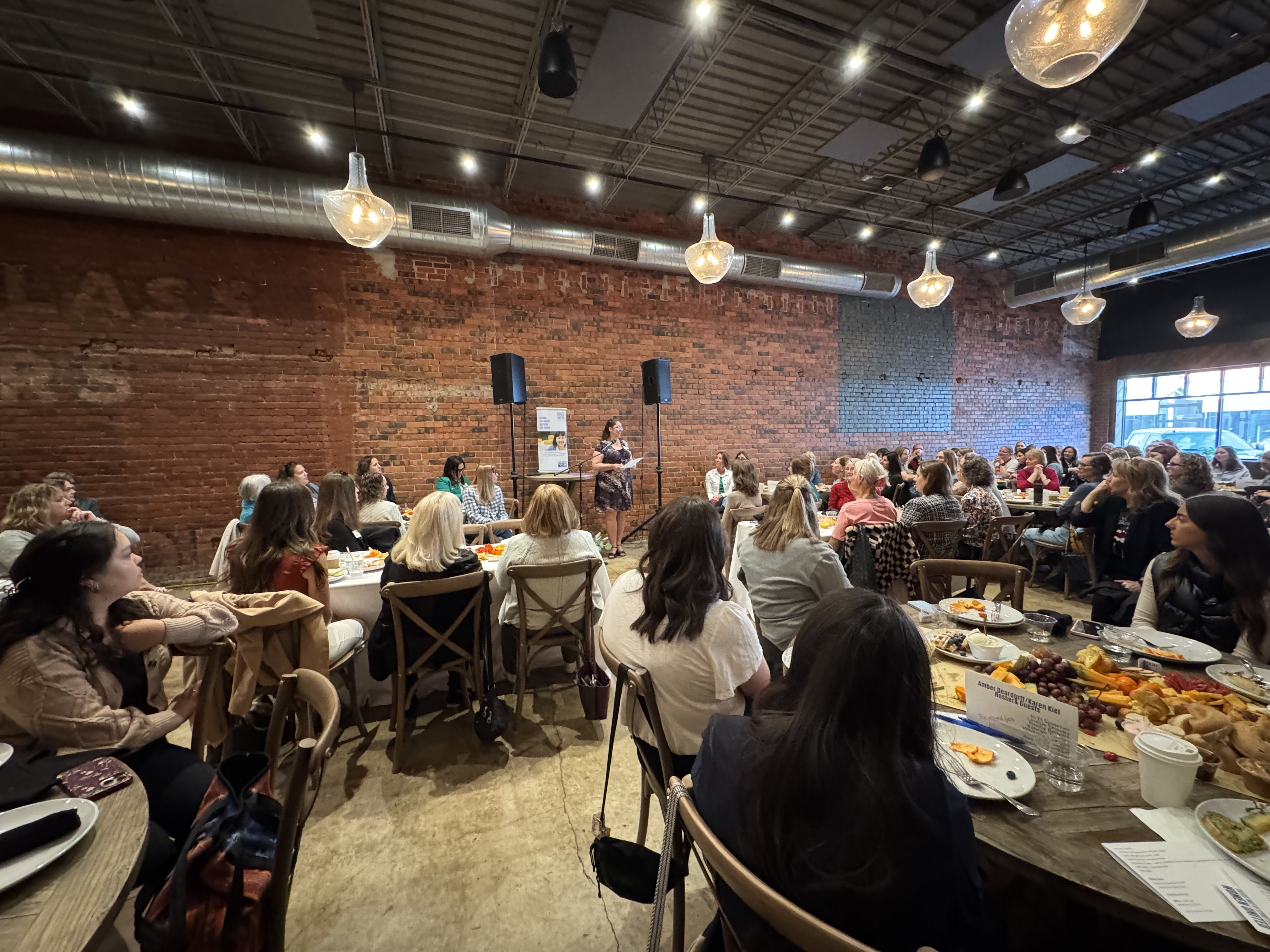
United Way's Response
Invest in tools to build long-term financial stability to 1,000 households annually
Volunteer Income Tax Assistance (VITA)
Financial education and coaching
Sliding fee scales at child care centers
Women United

Slide 9
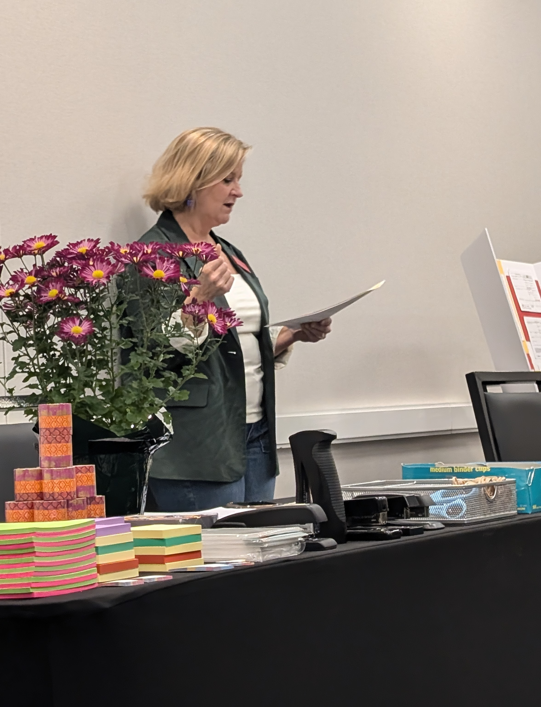
Overview of Request for Proposal (RFP)
2

Slide 10
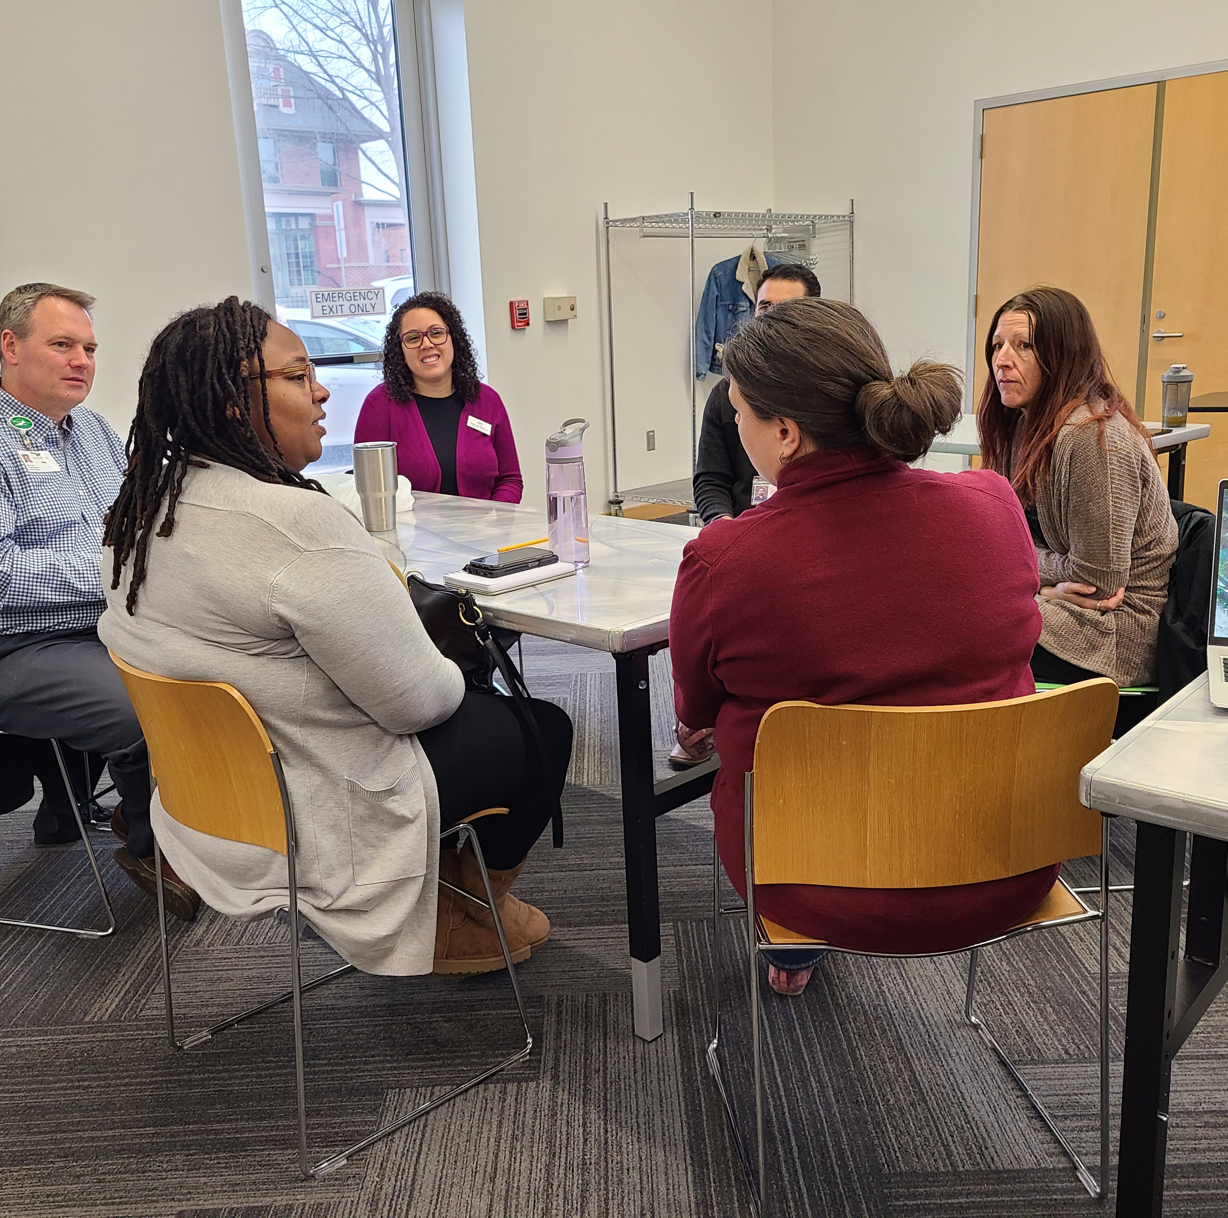
RFP Overview
$100,000 available to be allocated
Grant award will be paid out in one lump sum
Programming expected to last over upcoming fiscal year (July 2026 – June 2027)
Elements of trust-based philanthropy
For more details, review our Request for Proposal (RFP)

Slide 11
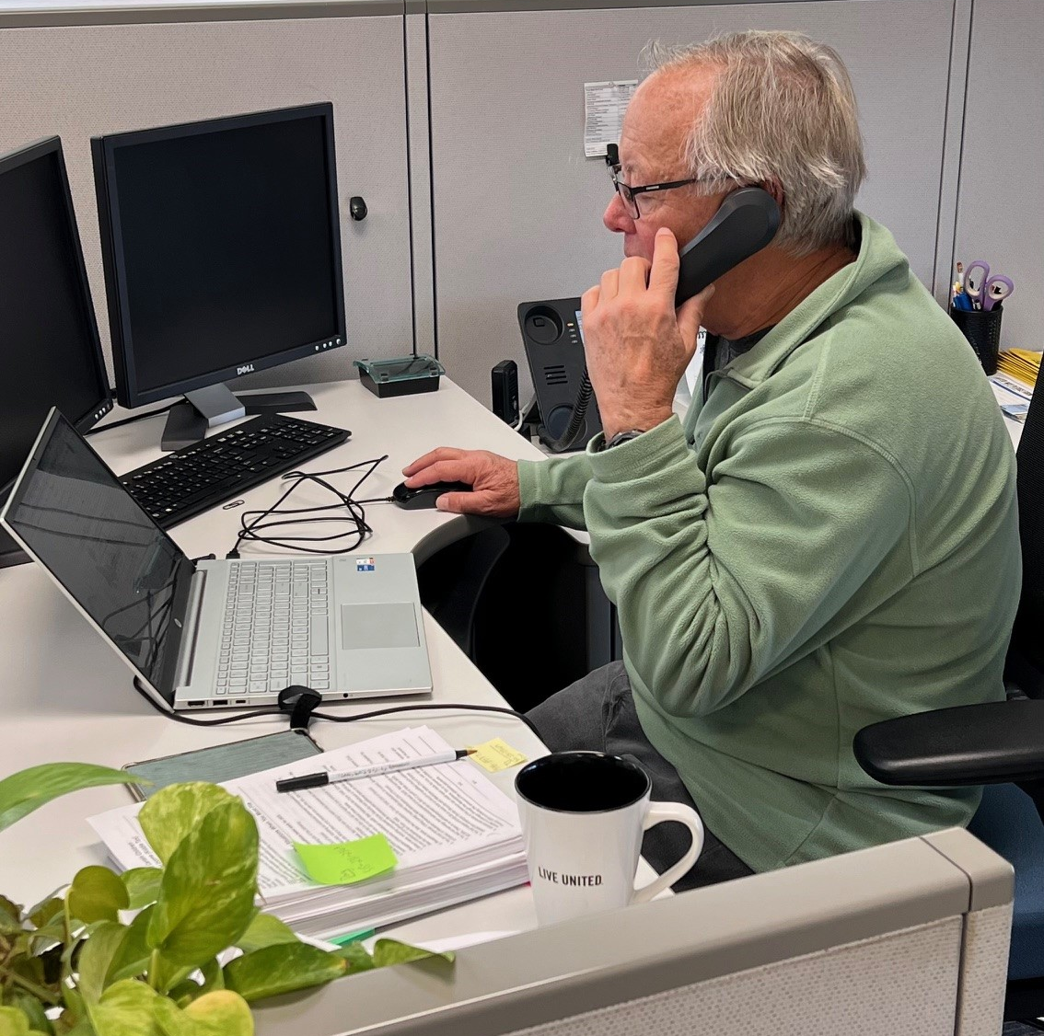
Major Grant Specifics
Focused on Financial Empowerment for low to moderate income people in Story County
Seeking bold, unique, innovative ideas
Some differences from ASSET and other UWSC grant processes
An open-ended granting model as opposed to “purchasing services”
Joint applications welcome and encouraged
Opportunity for collaboration and partnership

Slide 12
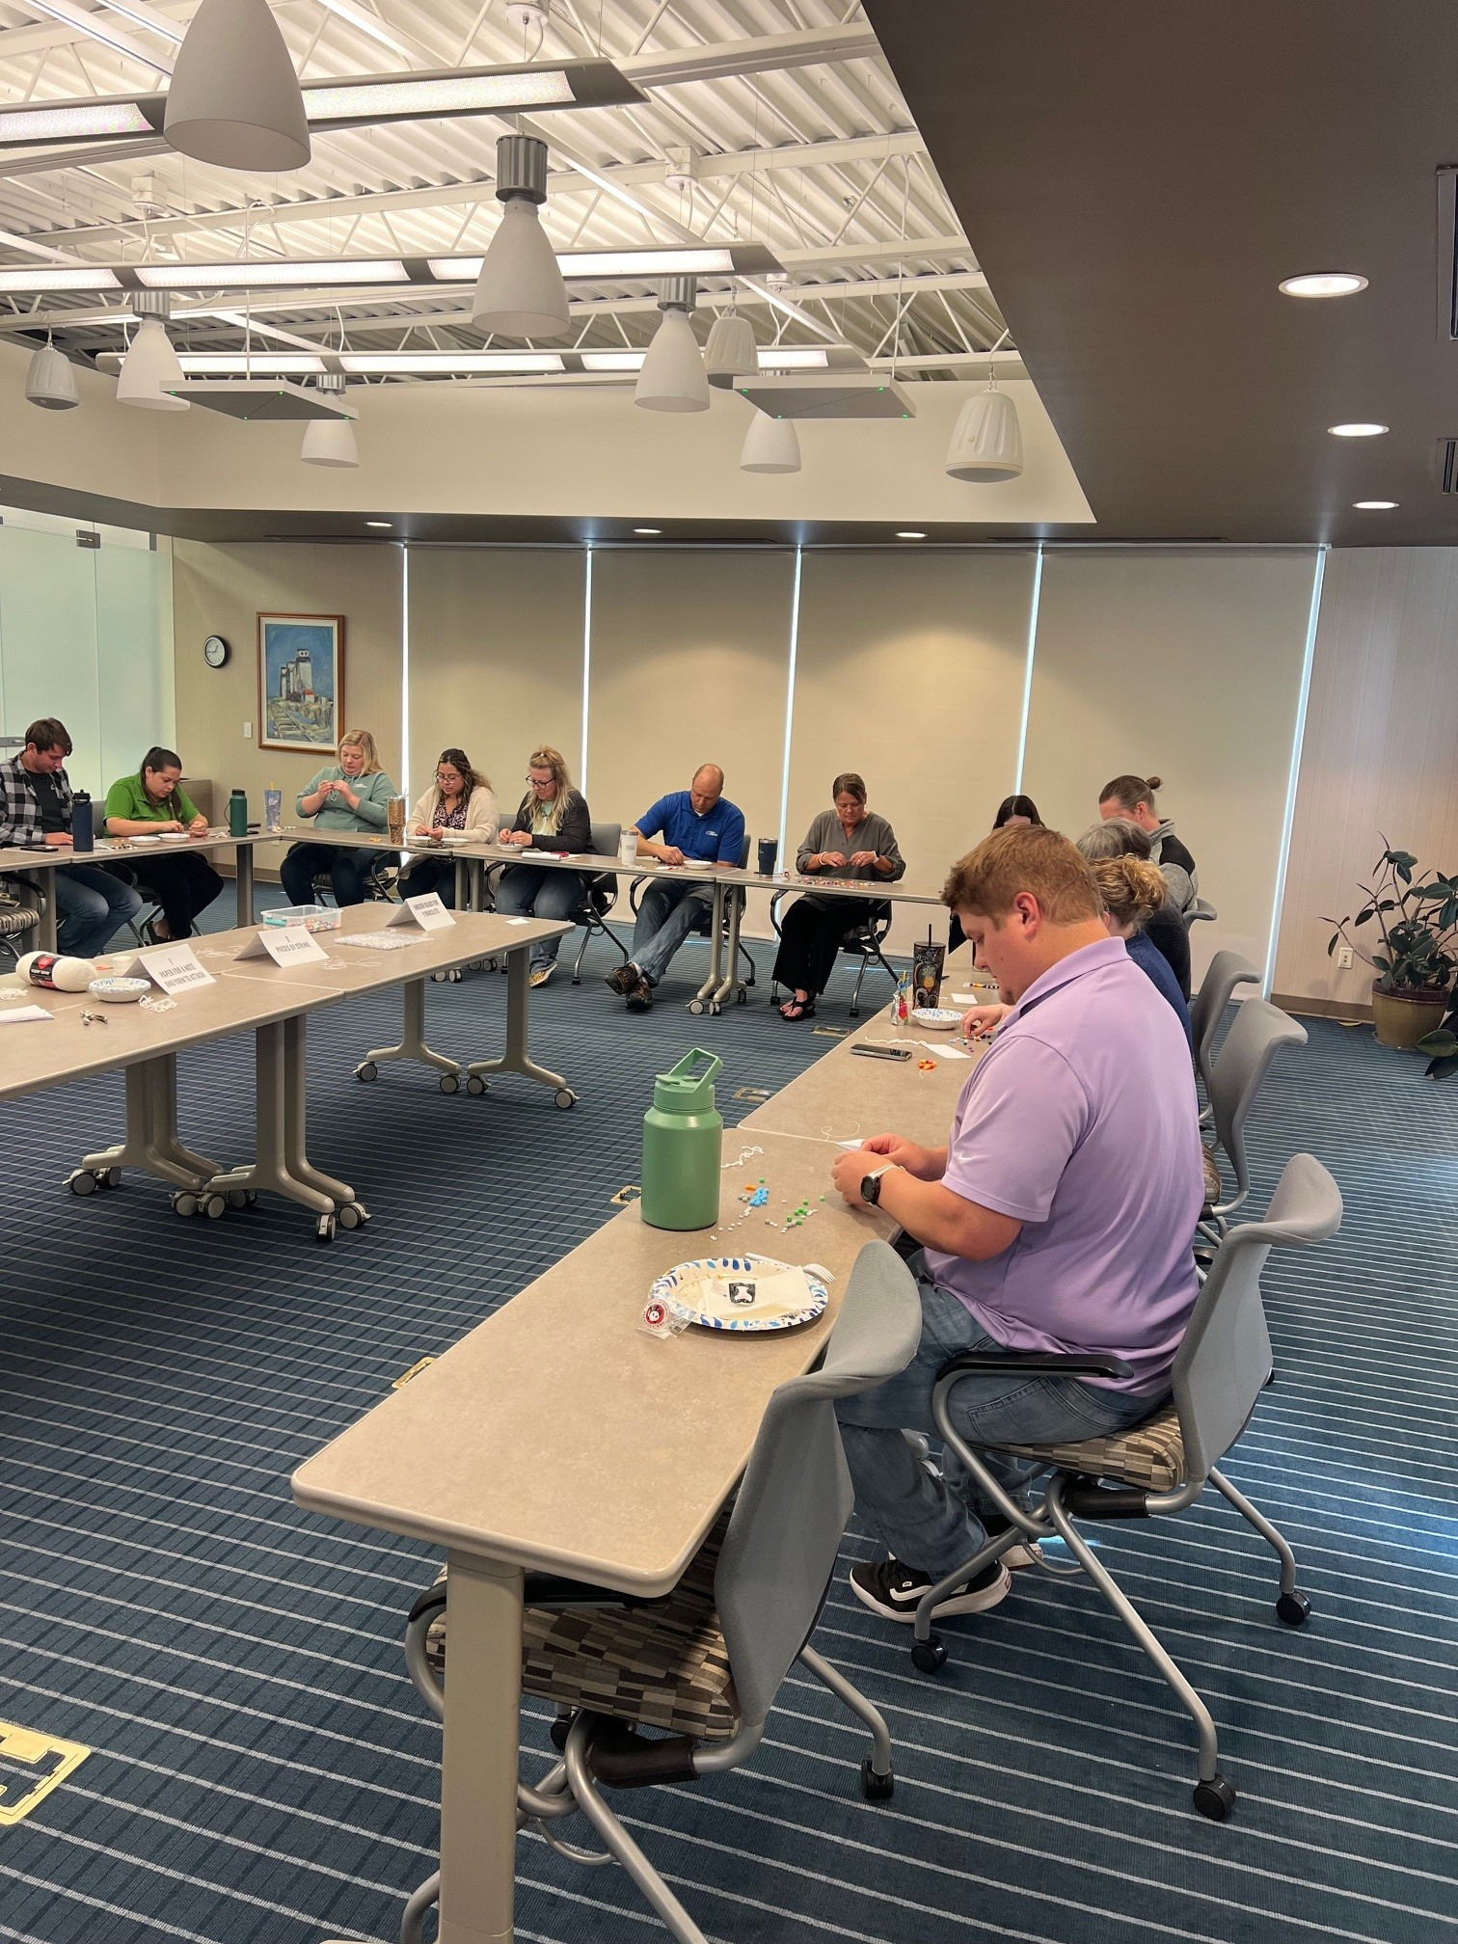
Project Topics and Activities
3

Slide 13
Eligible and Encouraged
New and unique ideas (not currently funded through UWSC or ASSET)
Focus on programming and initiatives
Higher-level systems work
Investing in tools and technology to improve service delivery and create efficiency
May include software licenses, equipment, training and/or professional development
Services that address more than one challenge related to financial empowerment
Transportation, child care, employment, housing

Slide 14
Not Eligible
Existing ASSET-funded services
Expanding currently-funded UWSC investments
One-time purchase of goods for distribution (food drive, holiday gifts, winter gear, etc)
Salary only without other programmatic investments
Capital campaign, including new construction and renovation
Religious or political activities
Non-essential program expenses (prizes, t-shirts, etc)

Slide 15
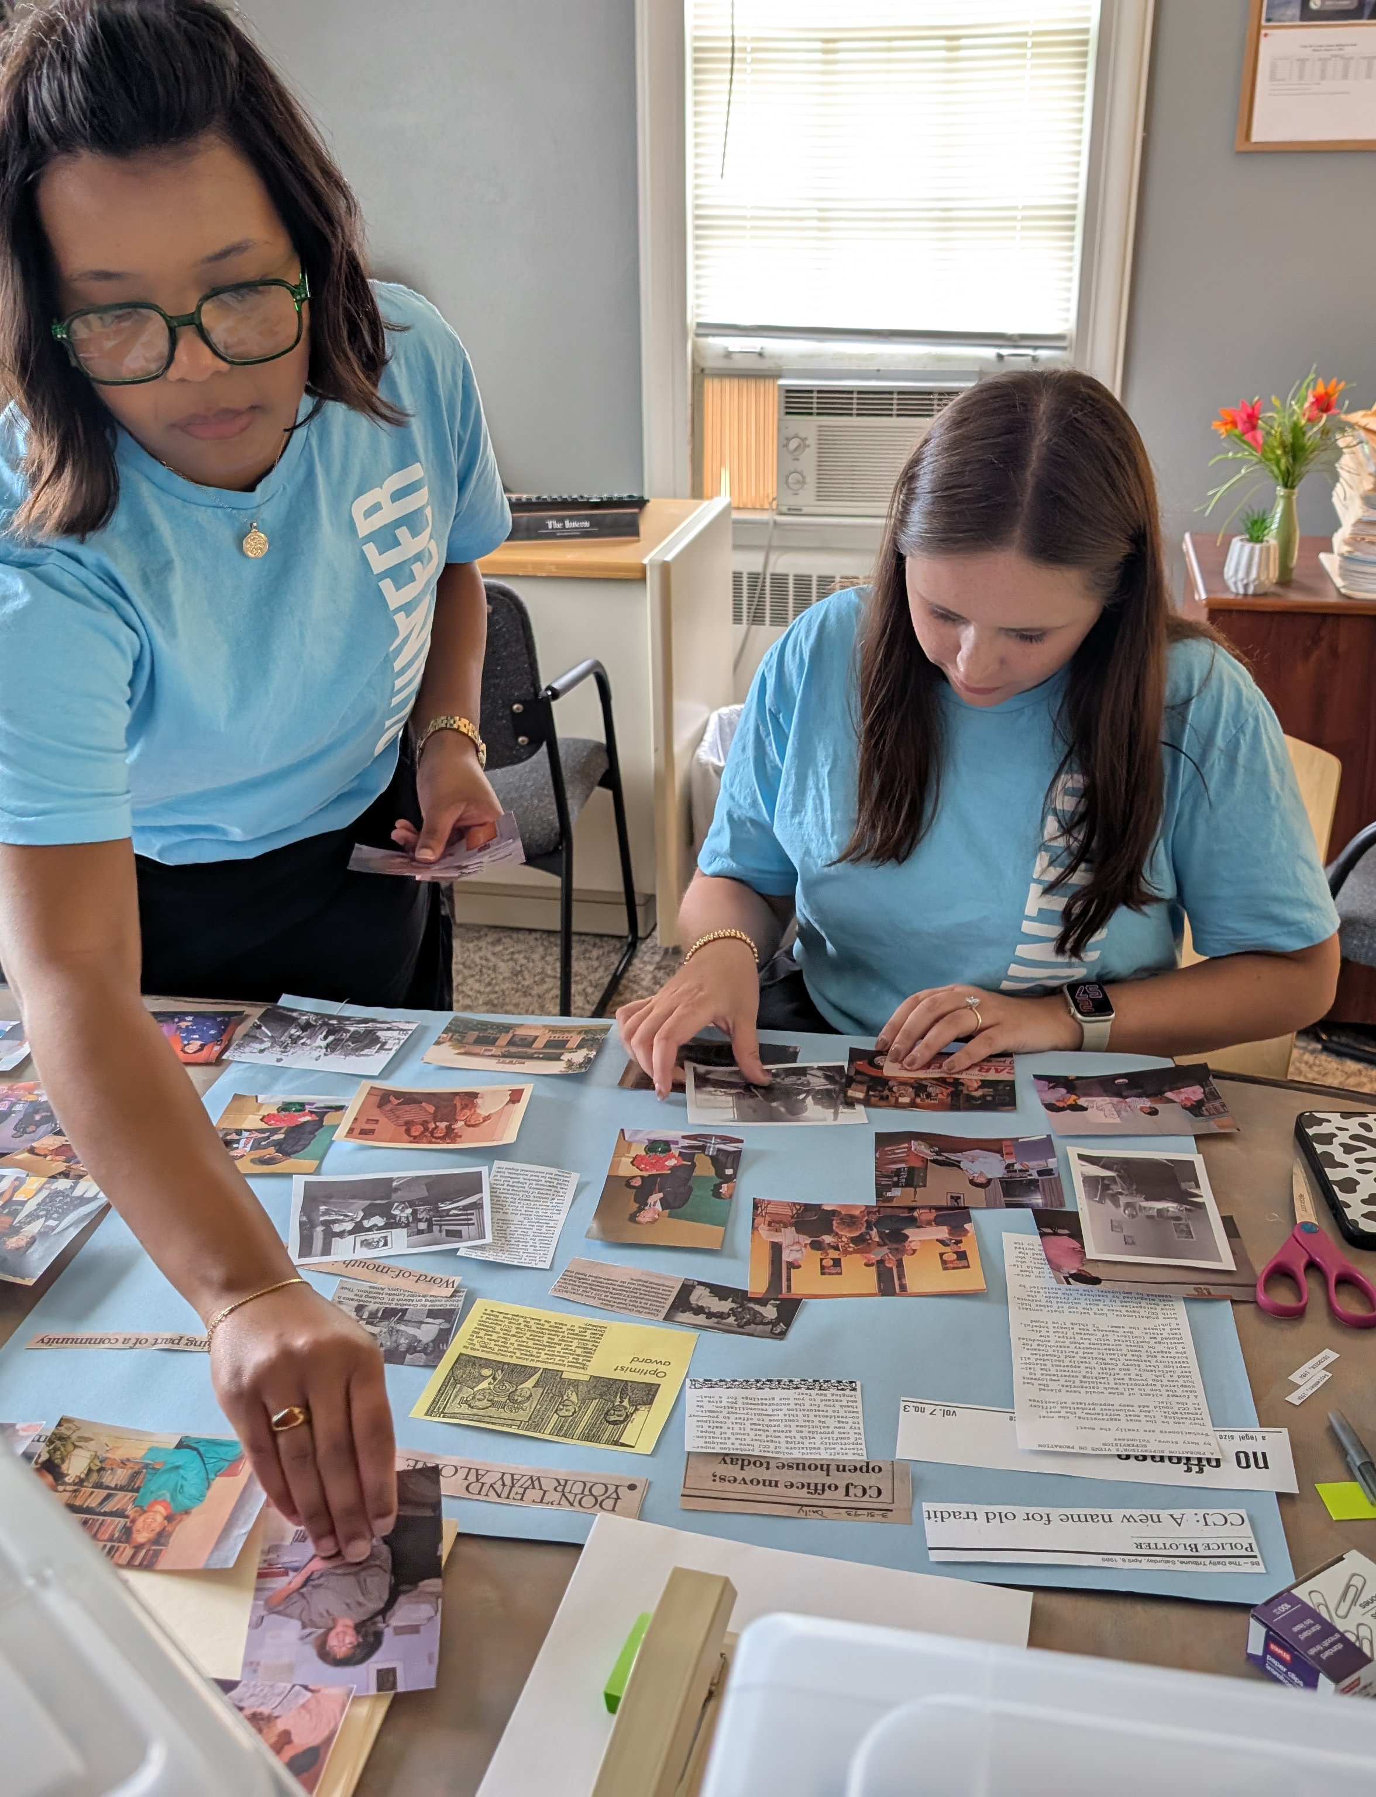
Drafting a Successful Application
4

Slide 16

Strategies for Success
Alignment with UWSC Financial Empowerment goals
Serve low to moderate income people in Story County
Talk to CI staff throughout the application process
Connect your idea to existing needs in the community
Seek matching funding and/or community resources
Establish partnerships and identify opportunities for collaboration
Nonprofit agencies, volunteers, and more

Slide 17
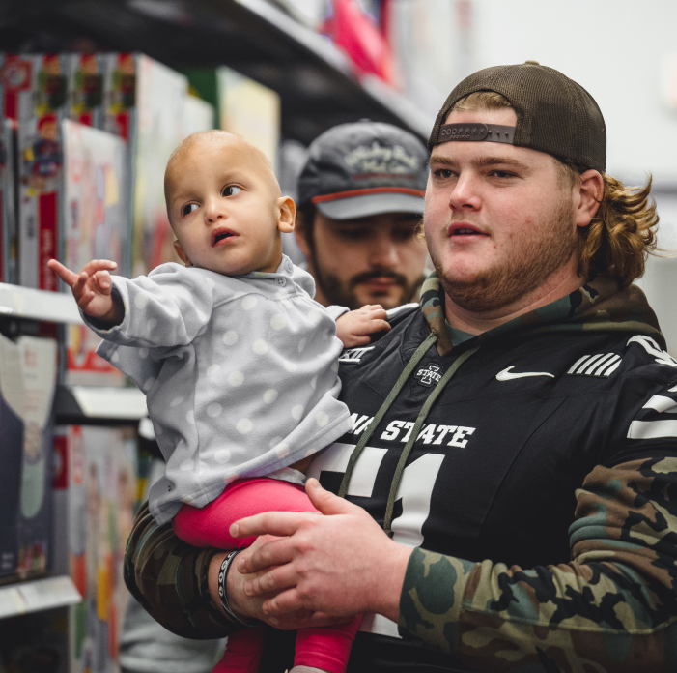
Data and Outcomes
Data collection and evaluation
What is your past/current experience with this?
What can you reasonably report to us?
Clear outcomes, measurable impact on people’s lives
What did you do?
How well did you do it?
Is anyone better off?

Slide 18
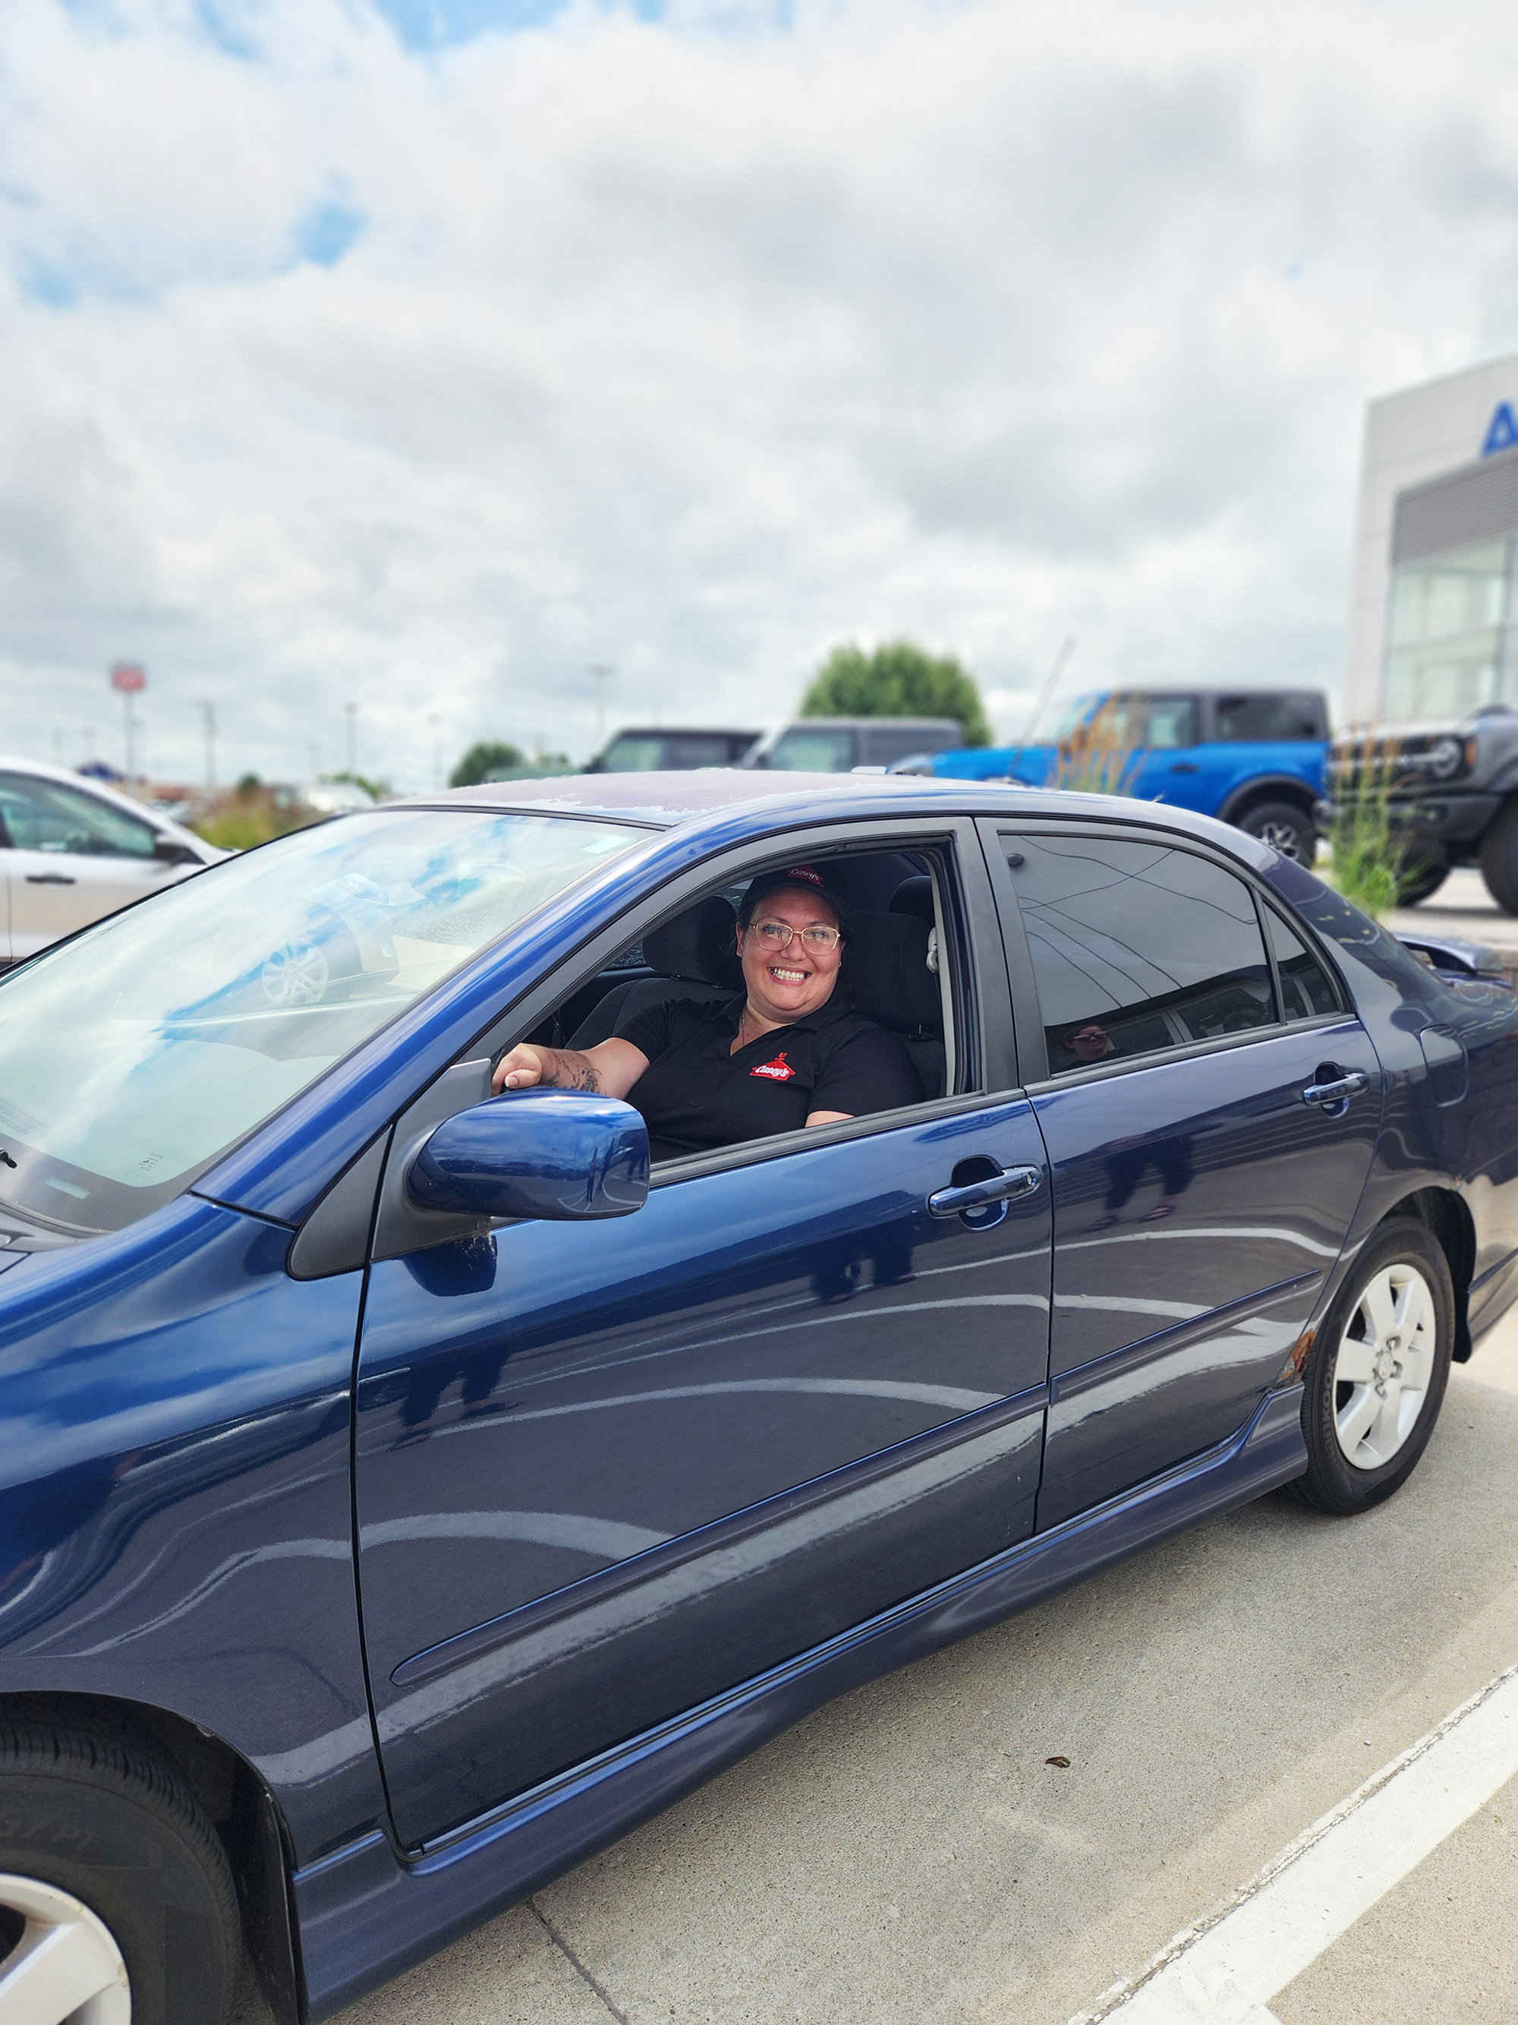
Submitting Your Application
5

Slide 19
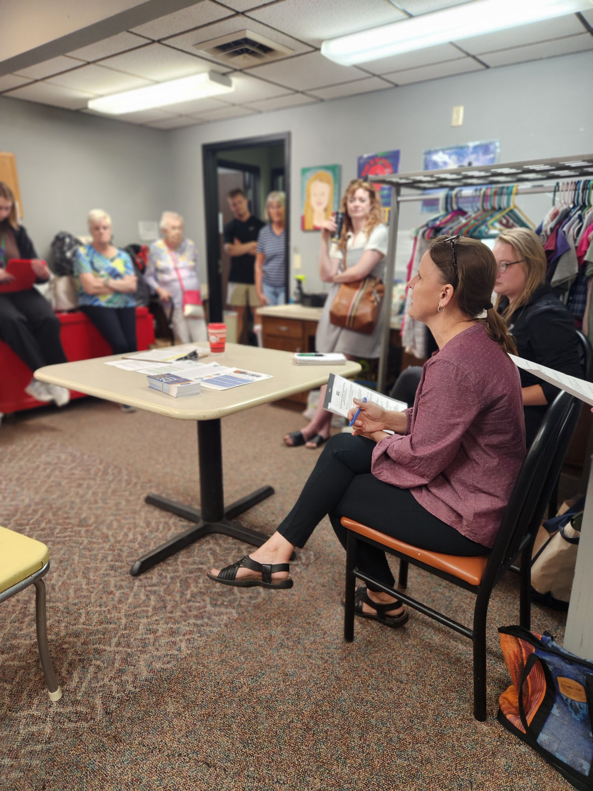
Required Steps for All Applicants
Letter of Intent
Video and slide deck
Office hours: RSVP here
Full Application and Budget Form
preview on our website: application and budget
Presentation/Q&A Session

Slide 20
Additional Materials for Submission
During Full Application Stage
New to UWSC?
Joint application?
Board of Directors roster
IRS Form 990
Financial information based on agency budget
see website and PDF for specific details
MOU or Partnership Agreement
Helps ensure aligned roles, shared accountability, and coordinated service delivery that improve outcomes.

Slide 21
Application Process
Date | Event and/or Milestone
Now through March 23, 2026 | Letter of Intent (LOI) process open Weekly office hours with Community Impact staff: RSVP here
Monday, March 23, 2026 | LOI deadline at noon (12:00 PM) submitted to unitedway@uwstory.org
Wednesday, March 25, 2026 | Final LOI results notification and invite to full application
Wednesday, April 15, 2026 | Full application due at noon (12:00 PM) submitted to unitedway@uwstory.org
Wednesday, April 29, 2026 | Full application results notification and invitation to presentation
Thursday, May 7, 2026 | In-person presentation to UWSC Allocations Committee from 8 to 9:30 AM
Friday, May 29, 2026 | Funding decision notifications/announcement

Slide 22
Post-Award Timeline
Date | Event and/or Milestone
June 1 - 5, 2026 | Recipient(s) meet with UWSC staff for data collection planning
Friday, June 12, 2026 | Signed Grant Agreement Letters due back to UWSC by email
July 1, 2026 - June 30, 2027 | Funding and programming expected to last for one fiscal year Quarterly reports and/or check-ins due: September 30, December 31, March 31, and June 30.
June 30, 2027 | Final reports due (or when project is completed)

